Slide 2
Mars Attacks
ITE 382 - Spring 2022
Alyson Mosely

Slide 3
Overview
Arcade game with a space theme
Player icon is a rocket ship
Player must dodge and destroy alien spaceships
Player can fire bullets at enemy ships to gain points
Player is issued three lives every game
Difficulty increases after player obtains 10, 25, or 50 points

Slide 4
How I Created It
Followed Matt Heaney Apps on YouTube
Downloaded the main font from DaFont.com
Created the assets in ProCreate
Purchased a sound package from Audio Jungle

Slide 5
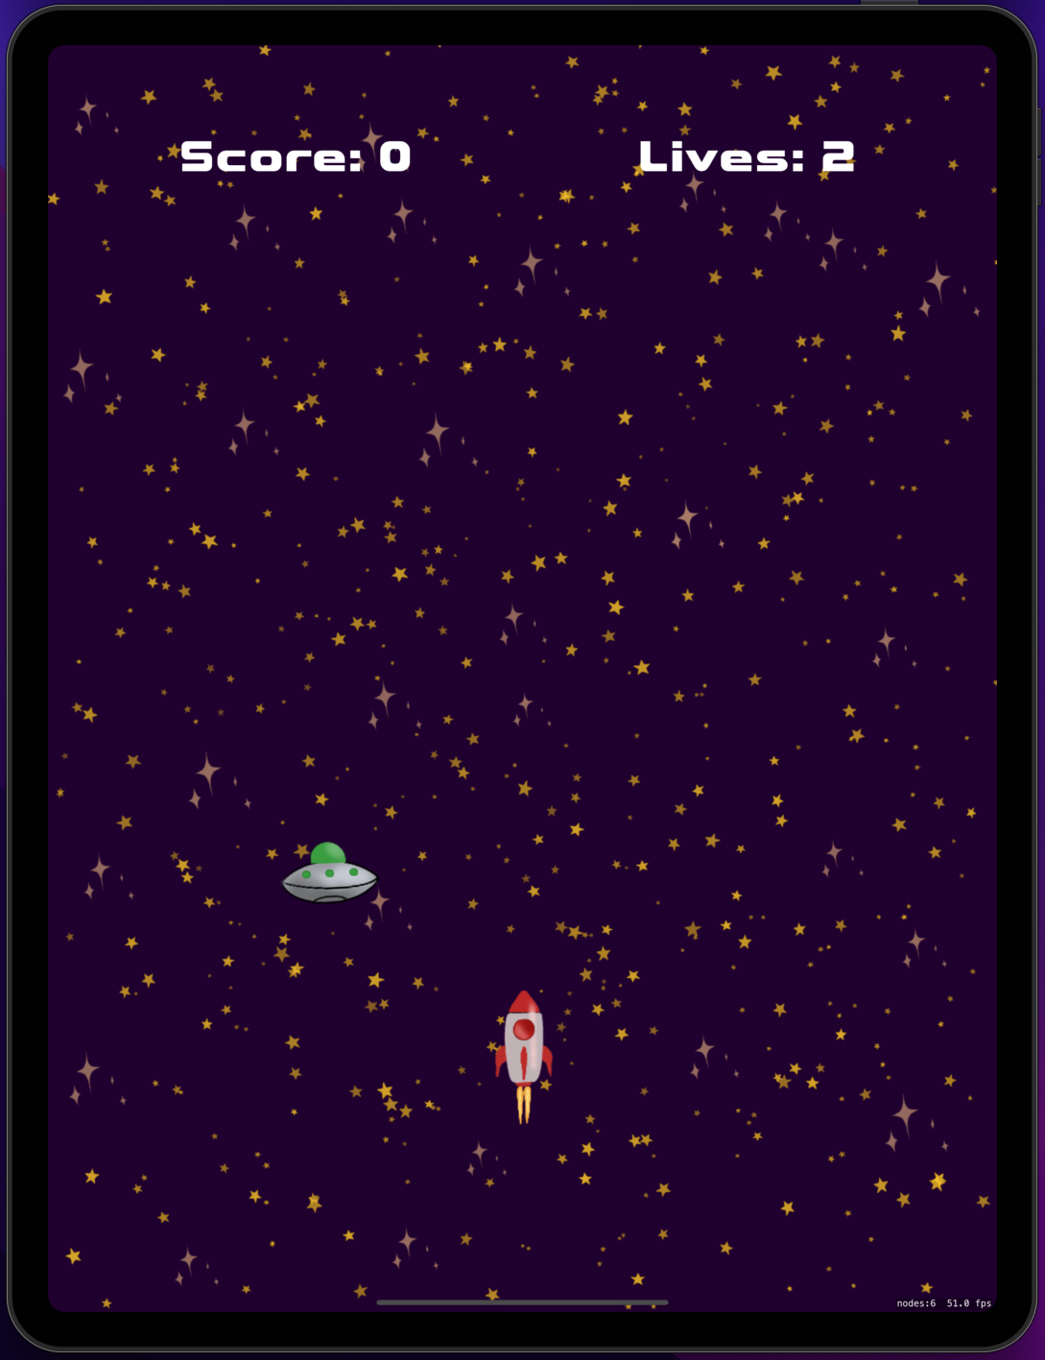
Game Scene
Lives has decremented because an enemy got past player
Score is zero since we have not fired

Slide 6
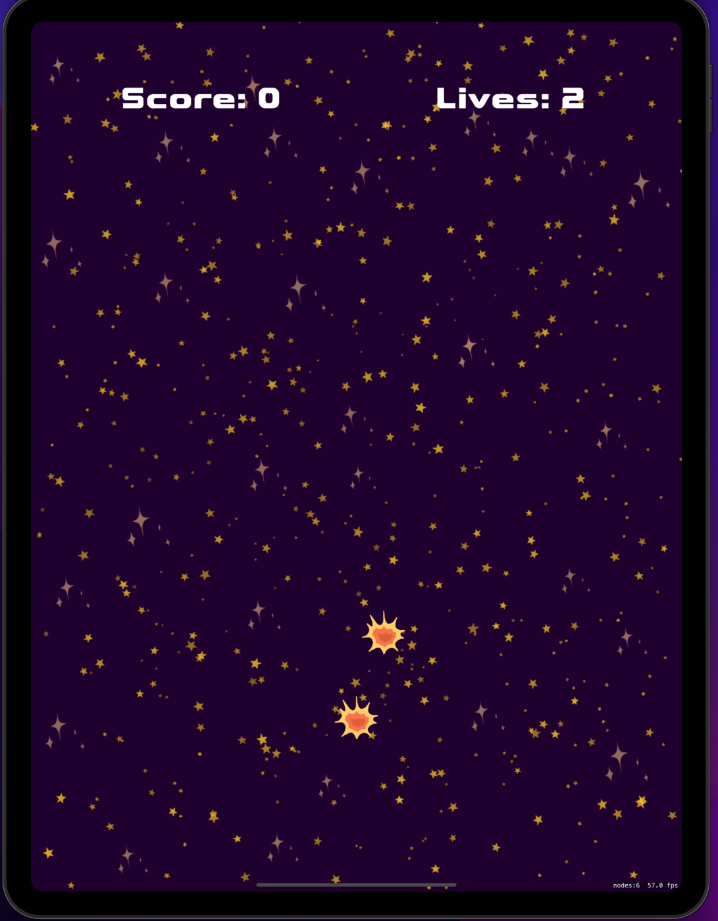
Critical Hit
When an enemy ship hits the player, an explosion occurs
This cues game over

Slide 7
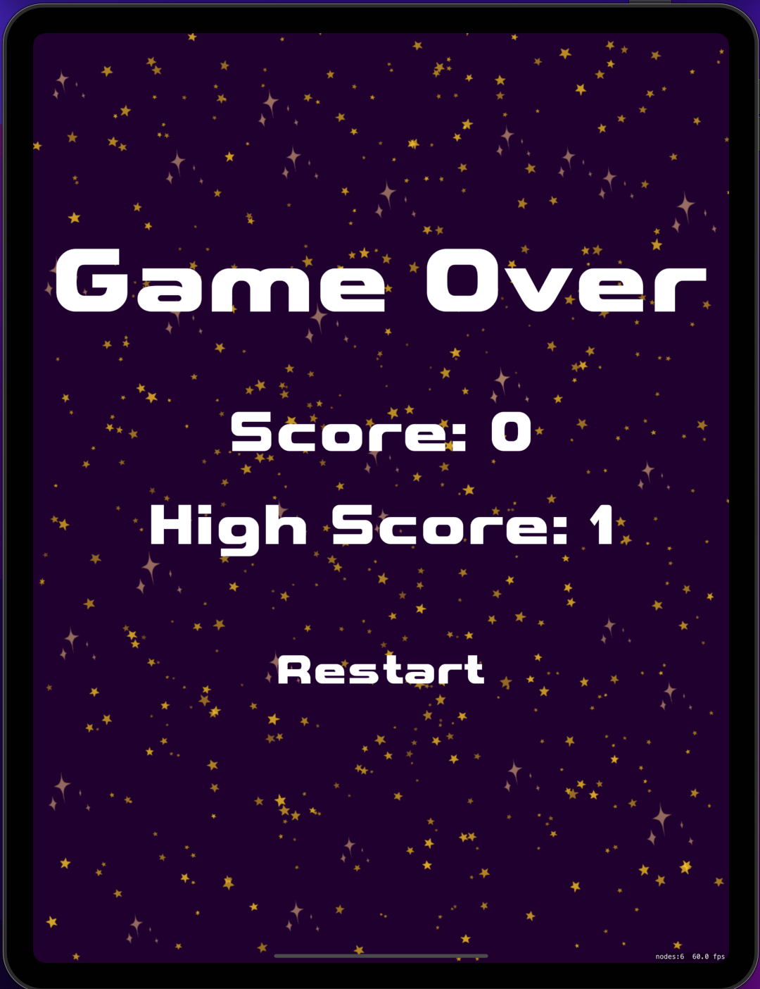
Game Over
Game over screen displays
Current score
Users highest score on that device
A restart button

